Slide 1
Unit-VII

Slide 2
Discuss Security & Trust IoT Communication
Secure Communication
IoT security framework

Slide 3
Discuss Security & Trust IoT Communication
All these below mentioned applications, have some common security requirements
Traffic Cameras(WLAN)
Metering
Vending Machines(Stock level)
Asset or Cargo Tracking

Slide 4
Discuss Security & Trust IoT Communication
Security threats for IoT
Physical Attacks
Compromise of Credentials(Brute Force Attack)
Configuration Attacks
Protocols attack on the device(Man-in-Middle)
Attacks on the core networks(Threat to mobile n/w operator)
User Data and Identity Privacy Attacks(eavesdropping)

Slide 5
Discuss Security & Trust IoT Communication
The Trusted Environment
Introduction to trusted Environment(TRE)(Extension-Verification)
Requirements, Functionalities and Interfaces
symmetric/Asymmetric encryption and decryption
Hash value calculation and verification(large to fix)
Random Number generation(Generate Cryptographic keys)
Digital Signature generation and verification
Verification of Trustworthiness of M2M
Validation
Autonomous Validation(local)
Remote Validation(Passive local)
Semi Autonomous Validation

Slide 6
Secure Communication
Authentication: provides the communicating parties with a way to verify their identity.
Availability: ensures that the system remains operational even in the presence of malicious or faulty nodes.
Confidentiality: Guarantees that communicated data is accessible only to the intended recipients.
Integrity: enables the recipient of a message to verify that a message was not altered while in the network

Slide 7
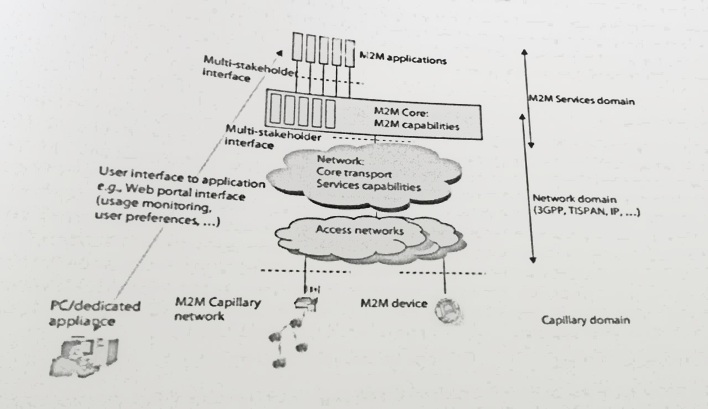
IoT Security Framework
IoT Service Domain=IoT Core +IoT Applications

Slide 8
IoT Security Framework
Communication and Sensors Devices: end point of IoT applications.
Routers and gateways: end point of the operator’s network where sensors and IoT devices do not connect directly to the network.
Machine to Machine Applications: based of infrastructural assets.
Operator Platform(Service delivery platform)

Slide 9
Discuss Security & Trust M2M Communications; Secure Communications; | CO3
M2M Security Framework; Securing Data Input / Output and internet communication | CO3

Slide 10
Discuss Wireless Sensor Networking (WSN);
Cellular Machine-to-Machine (M2M) application networks; Software for M2M Applications, Hardware
IP Based Cellular Networks & 3G, 4G.

Slide 11
Discuss IOT Requirements; Hardware & Software
Study of IOT Sensors, Tagging and Tracking
Embedded Products
IOT Design, (U) SIM Card Technology
IOT Connectivity and Management

Slide 12
Study of RF Wireless Sensors; Wireless Networks
Computer connected to Internet; Network Devices; Device Configuration and Management
Exchange information in real time without human intervention

Slide 13
IOT Verticals; IOT Hosted Services;
IOT Application development; IOT Connectivity
IOT Software providers.

Slide 14
Automation, asset management, telemetry
transportation, telematics
Telemetry and Telemetric; Report location
logistics, tracking and remote assistance
Next generation kiosks, self-service technology
Cellular IOT connectivity services

Slide 15
IOT Concepts, Introduction to IOT Communications, Telemetry vs IOT
Applications of IOT Communications, People, Processes and Devices

